Slide 1

Scene-Aware
A Real-Time Hybrid Assistant for the Visually Impaired

Slide 2
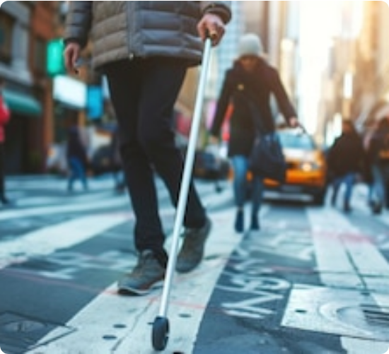
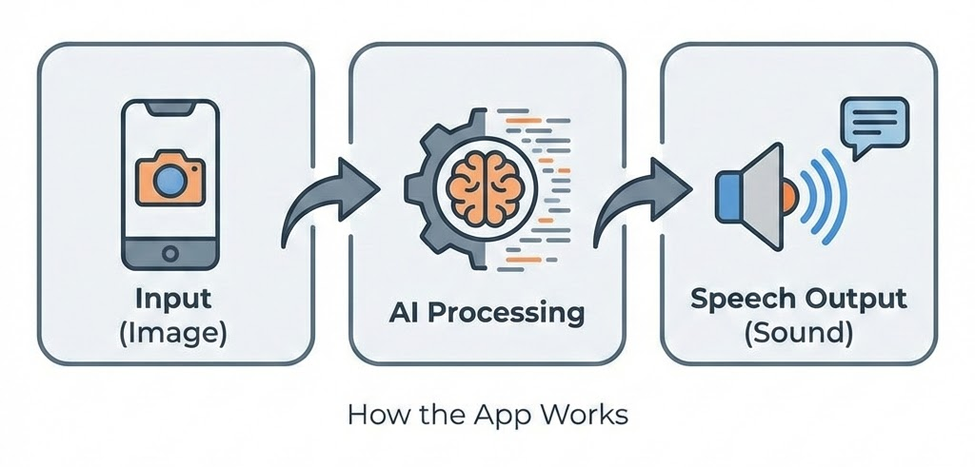
Problem
Solution
Understand the surroundings quickly and accurate.

Slide 3






Engineering Constraints
To create an accessible, scalable tool, we faced a "Triangle of Trade-offs":
Hardware Limits
Efficiency
Reasoning
Must run on accessible devices with < 2GB RAM usage. Not everyone owns a flagship phone.
Real-time processing is non-negotiable for safety. Latency causes accidents.
Visual reasoning capacity is needed to describe complex, dynamic scenarios.

Slide 4
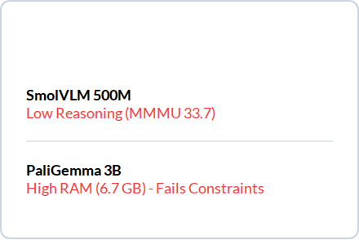
Initial Approach: The Trap of "Small" VLMs
Strategic Misalignment
We initially attempted to use small-parameter Vision-Language Models (like SmolVLM) entirely on-device.
Benchmarks
The Result: Failure.
Too Slow: Couldn't proactively prevent accidents.
Too Simple: Lacked the "College-level" reasoning (MMMU) to answer complex environmental questions accurately.

Slide 5


Final Approach: Hybrid Architecture
Layer 1: Local (Device)
Layer 2: Remote
YOLO v8 handles real-time object recognition. Zero network latency. Pure safety.
Moondream 3 handles scene description and dialogue. High capacity reasoning for detailed queries.

Slide 6
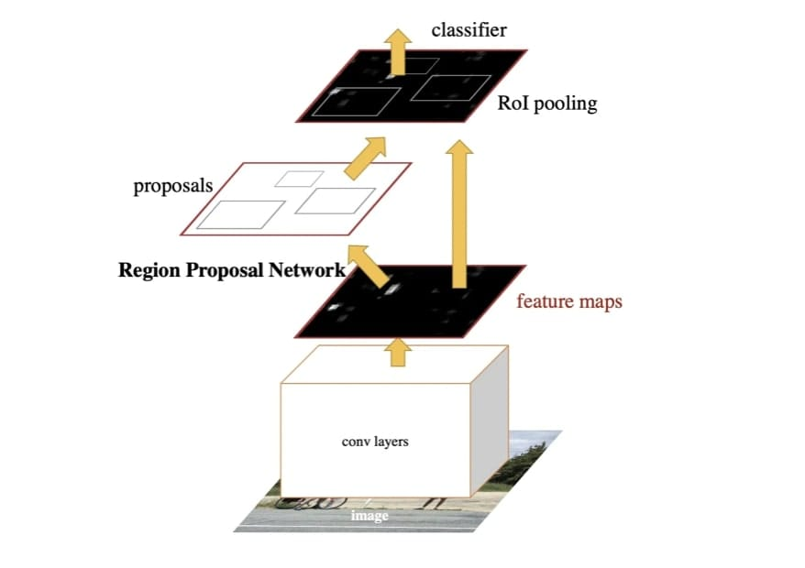
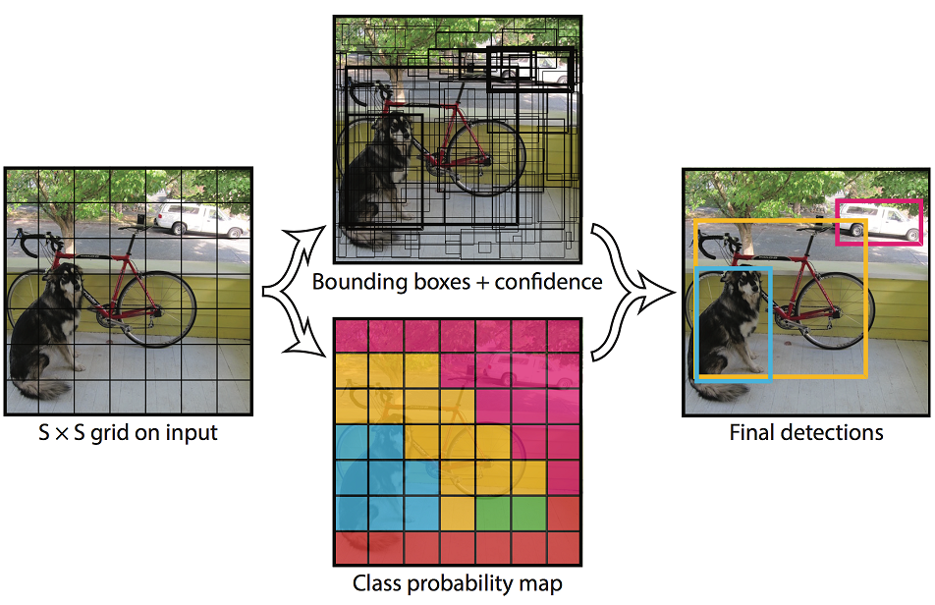
Layer 1: Object Detection

Slide 7
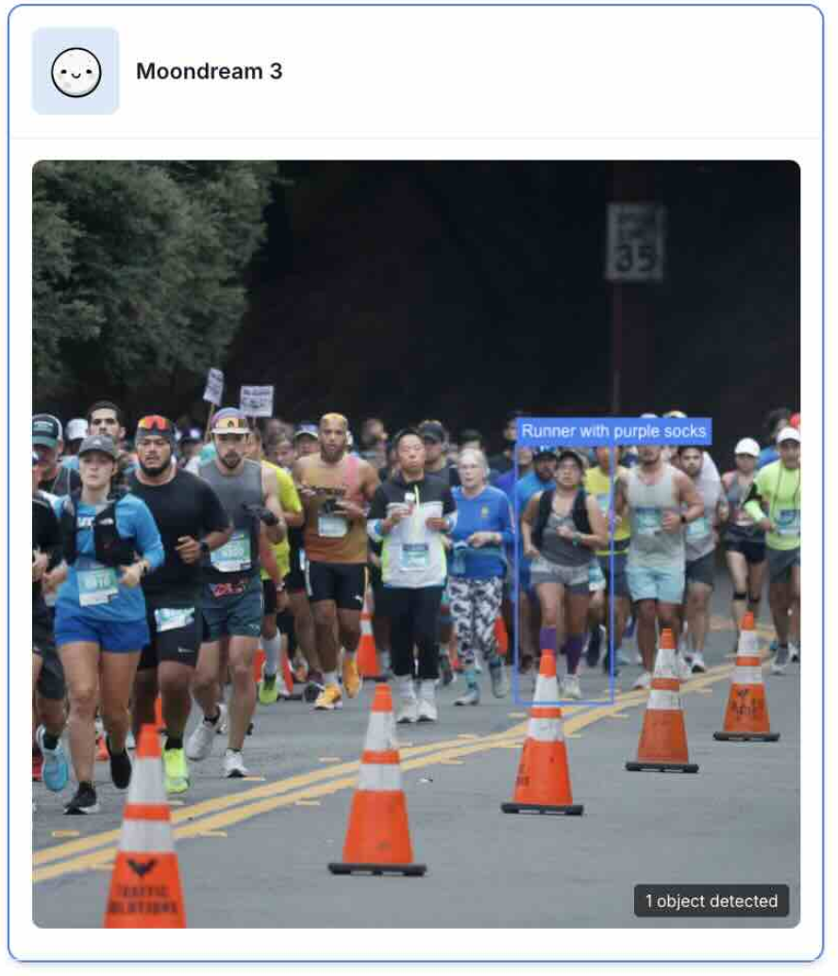
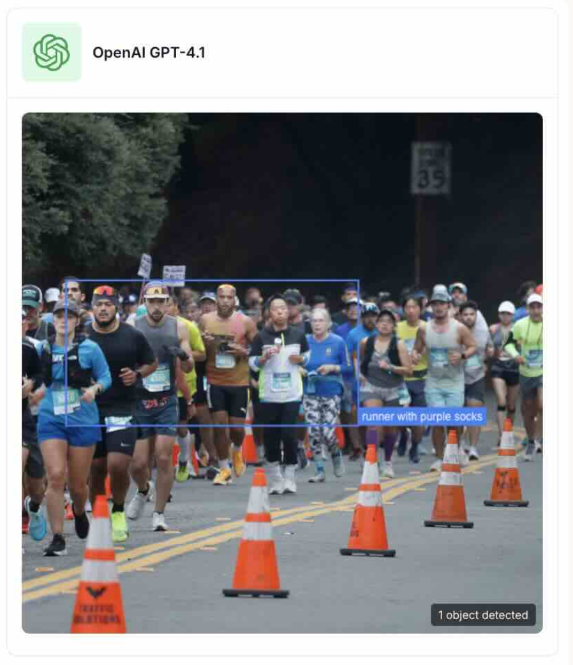
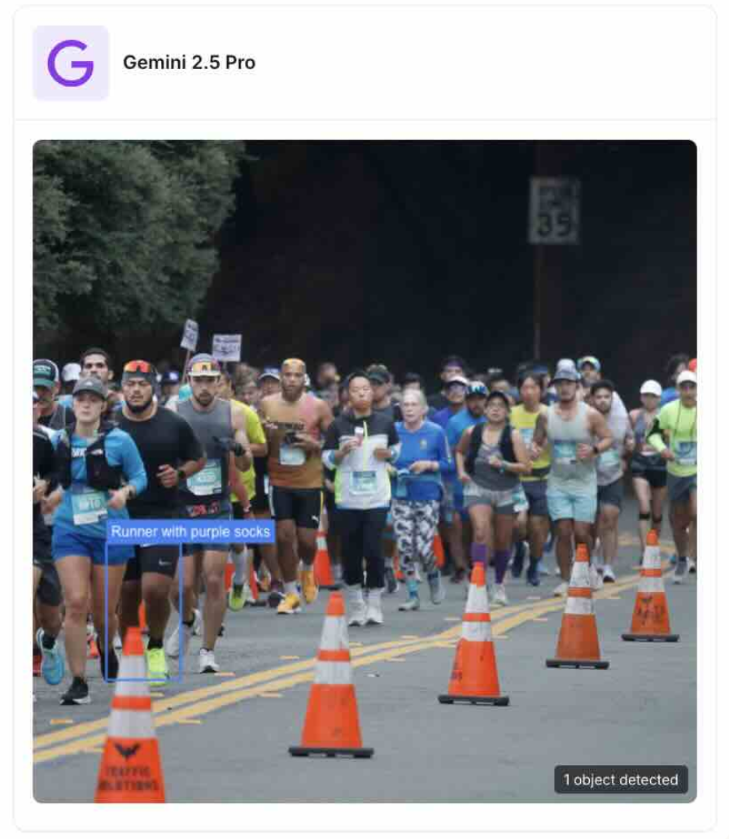
Layer 2: Deep Understanding
Prompt: "Runner with purple socks"

Slide 8
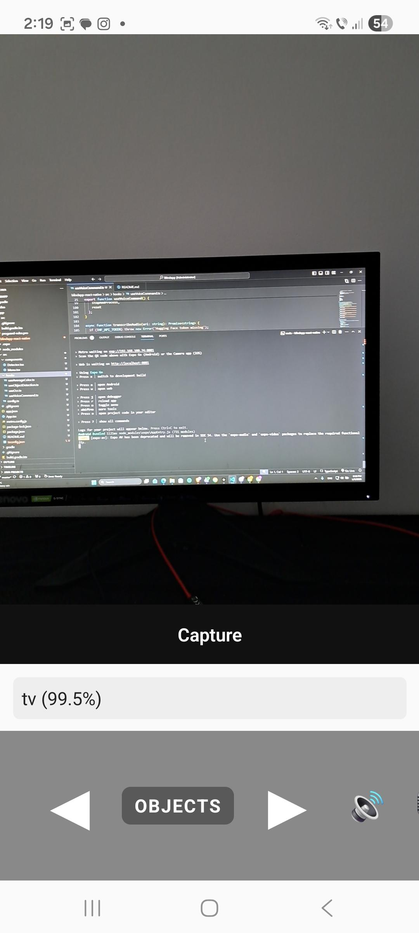

The App
Scene Aware Assistant — User Experience
How the App Is Used
Voice-first mobile app
User opens app
Camera-based awareness
Asks a question
Hands-free interaction
Gets spoken feedback

Slide 9
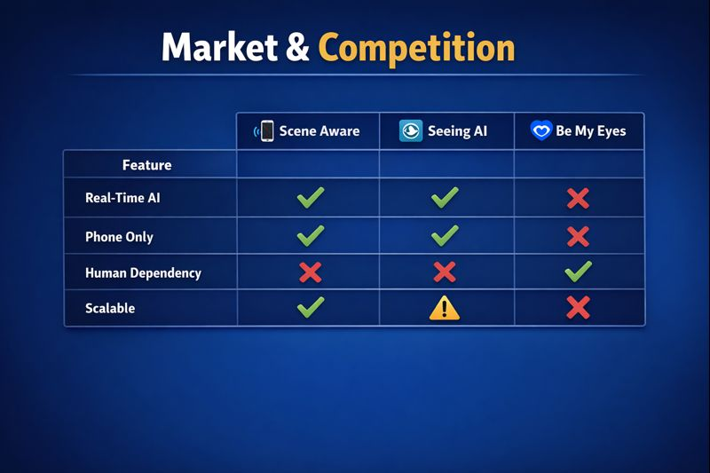
Market & Competition
Market positioning
Concrete numbers:
285M visually impaired worldwide
partial
Assistive tech market: ~€6–7B
Software-based accessibility growing ~8–10% / year

Slide 10
Business Model
How we make money Break-even point:
1000 € / 10 € = 100 users
=>5 months of having 200 premium users
Freemium model Who pays Assumptions
Free: basic detection
(only local)
Fixed costs: ~€5,000 for initial implementation
Individual users
NGOs / institutions
~€1,000 monthly running costs
Premium: €10 / month
(includes cloud processing for complex queries)
Price: €10 / user / month
Accessibility programs

Slide 11

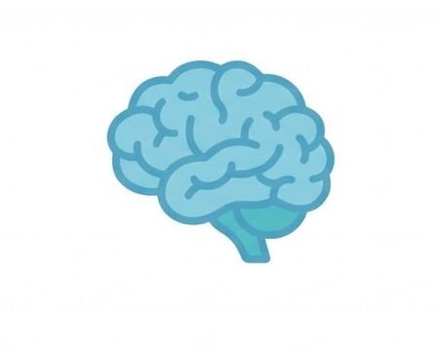
Conclusion
Solved the Accessibility Paradox

Slide 12

Thank you for your attention.

Slide 13
Sources
https://moondream.ai/blog/moondream-3-preview
https://arxiv.org/pdf/2504.05299
https://huggingface.co/blog/smolvlm#benchmarks
https://arxiv.org/abs/1506.01497
https://pub.towardsai.net/yolo-a-benchmark-in-object-detection-classification-bf60a5e3cfcc

